Slide 1
DMML Video Presentation
By
Rajesh Ramachandran Nair
X20141289
MSC Data Analytics

Slide 2
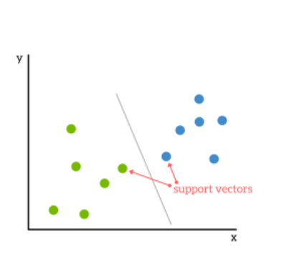
Support Vector Machine
Supervised Machine Learning Algorithm
Used for both Classification and Regression

Slide 3
Idea
Based on the idea of finding a hyperplane.
Based on the concept of a hyperplane that divides the data set in to classes
Support vectors are points nearest to the hyperplane.

Slide 4
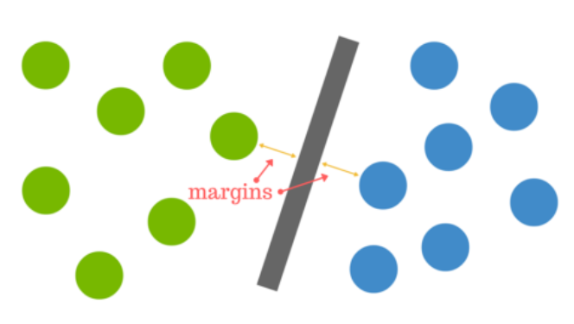
Right Plane
The main is to find the best possible distance from the margin to any of the data points.

Slide 5

No plane
How do i find a plane for this one?

Slide 6
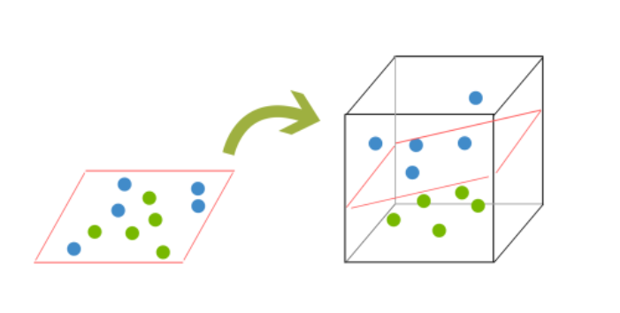
Highers Dimensions

Slide 7
Pros
  Accuracy
  Works well on smaller datasets
  It can be more efficient because it uses a subset of training points
Cons
  Training time can be high with big datasets
  Less effective on noisy data

Slide 8
Thank You

